Slide 1

Architecture; how does it save money and reduce risk in an organisation?
TEJINDER RAI
1/02/2022

Slide 2
Agenda
Key Topics
1 – What is Architecture?
2 – Business challenges without architecture?
3 – Why is architecture important?
4 – Real world example, shaping the architecture
5 – How architecture reduces risks and costs?
6 – The Endgame
7 – Questions

Slide 3
What is architecture?
The Gartner definition of Architecture:
1. In reference to computers, software or networks, the overall design of a computing system and the logical and physical interrelationships between its components. The architecture specifies the hardware, software, access methods and protocols used throughout the system.
2. "A framework and set of guidelines to build new systems. IT architecture is a series of principles, guidelines or rules used by an enterprise to direct the process of acquiring, building, modifying and interfacing IT resources throughout the enterprise. These resources can include equipment, software, communications, development methodologies, modelling tools and organizational structures."
Definition of Architecture - IT Glossary | Gartner

Slide 4

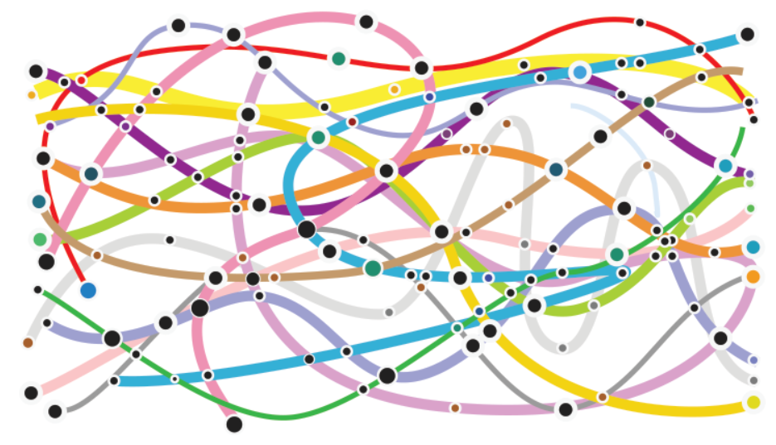

Business Challenges without Architecture - 1:
Reduced Governance – Leads to Challenges
Less Strategic
Short Term Focus / Quality
Challenges to support Business Vision
Higher
Complexity
Reduced
Sustainability
Leads
To… ->
Duplicated Capabilities
Higher Maintenance
Fewer Standards
Information Silos
Poor Foundations - ~ Limited Progression

Slide 5
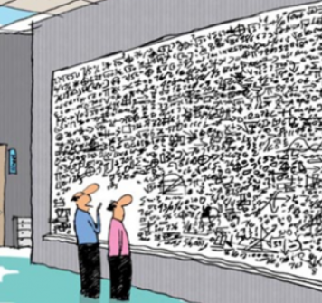
Business Challenges without Architecture - 2:
Leads to:
Complexity

Slide 6
Why is architecture important?
Support the underlying business vision
Deliver solutions holistically
Reduce complexity by understanding the business needs, changes and challenges, to shape the right solutions with strategic focus to meet both short term and long term goals
Improve stability and reliability
Support both tactical needs and roadmap the appropriate components with value and definitive objectives
Business
Architecture
Application
Architecture
Data
Architecture
Technology Architecture

Slide 7
Example challenge – Shaping the architecture 1
Business silos (Data, Technology and Systems)
Complex Integrations
Undocumented processes and integrations
Poor system architecture documentation
Data issues
Duplicated reporting capabilities, multiple systems
Regulatory standards were required, but not managed appropriately
Low confidence in business continuity and disaster recovery processes
On-premise based solutions

Slide 8
How architecture reduced risks and costs ~ 100,000ft view – Understanding the Organisation, Systems, Processes - 1
Departments
Staff
Technologies
Cost$
Planning and Strategy
Planning Analyst
Strategy Managers
Business Analysis
Resource Planning
Medium
Business Change
Change Managers
Change Analysts
Planning Tools
Document Management
Medium
SALES
Sales Managers
Selling Agents
CRM
Reporting
Dashboards
High
Leadership
Customer Investigations
Customer Services
Investigators
Customer Analysis
CRM
Reporting
High
HR & Finance
Finance Leads
HR Leads
Resource Planning
Multiple Financial
Reporting
High
IT
Multiple Disciplined Roles
CRM
Toolsets
Multiple Platforms,
Reporting
High

Slide 9





How architecture reduced risks and costs ~ Identifying the Dependencies, Risks and Costs - 2
Departments
Staff
Technologies
Cost$
Planning and Strategy
Planning Analyst
Strategy Managers
Network Analysis
Resource Planning
Medium
Business Change
Change Managers
Change Analysts
Planning Tools
Document Management
Medium
SALES
Sales Managers
Selling Agents
CRM
Reporting
Dashboards
High
Leadership
Customer Investigations
Customer Services
Investigators
Network Analysis
CRM
Reporting
High
HR & Finance
Finance Leads
HR Leads
Resource Planning
Multiple Financial
Reporting
High
IT
Multiple Disciplined Roles
CRM
Toolsets
Multiple Platforms,
Reporting, Document Management
High

Slide 10
How architecture reduced risks and costs
Review the business strategy
Identify common business capabilities
Review the business architecture, supporting roles, interactions and needs
Review the platforms, applications and services
Review the interdependencies between components
Review data architectures, development practices and skillsets
Review the costs (fixed costs, operating costs, support and maintenance)
Review overall technologies used in each department to identify common trends
Review data management and processes

Slide 11
How architecture reduced risks and costs The Endgame
Combine Sales and Customer Investigation Teams (Use a single CRM Platform) ~ set out a roadmap
Enterprise Document Management Solution
Planning, Strategy and Finance (Enterprise Resource Planning Solution; Use a combined system)
Planning and Strategy, Sales, Investigations, HR and Finance and IT; Implement a common data platform for reporting, develop an organizational data culture
Cost & Risk Reductions (Effort, Assets, Technologies, Opportunities)
  Reduced Reporting Solution Technologies (less costs, support and maintenance overall)
  Merged departments and utilised a single CRM system
  Enterprise Document management, provided a way to share data correctly, via the appropriate information architecture to reduce the risk of multiple systems holding company information
  Improved system architecture documentation to reduce risks to understanding the landscape
  Removal of point-to-point integrations (where possible)
  Single Resource Planning system, improved risks to corporate identities, expense management, single record location for other IT systems to leverage e.g. JML process for user identities
  New system rollout included formal DR procedures and testing
  Governance covered by the IT Architecture Team, with appropriate Business Change team involvement (business cycle)

Slide 12

Questions?

